Slide 1




K-mean Clustering in Web Service Quality Datasets Using AWS and RapidMiner
Kriti Gupta,
Department of Computer Science and Engineering
Amity University Uttar Pradesh (AUUP)
Noida, India

Slide 2
MOTIVATION OF THE RESEARCH
Compute the response time, availability and cost of available cab services.
Compare the prices and response time of cab services available to a customer.
Propose a web service using this comparison to find a suitable cab to the customer.

Slide 3
OBJECTIVE OF THE RESEARCH
The aim of this research is to develop a web service which is easily accessible to everyone.
This web service helps in comparing the real time cab service providers and finding the best suitable service for the customer using Google maps API for the purpose of calculating distance and time using source and destination as input.
The comparison is done using k-means in Rapid miner, a tool for prediction.

Slide 4
Introduction
The term ‘cloud computing’ originated in 1996. This technology was boosted by amazon.com when it released its product elastic cloud computing (EC2) in 2006.
It performs the delivery of pay per use of computing resources like, networking, database, software, storage, analytics, and much more resources online.
Services like Iaas, Saas, Paas helps in increasing elasticity, scalability and availability, load balancing in cloud computing.

Slide 5
Previous Research
Previously there is some work done on the web services using cloud computing.
The models that other authors have proposed are not completely coherent.
They proposed model which was not based on real time.
There is no work done regarding the comparison of web applications using web services and propose a suitable service.

Slide 6
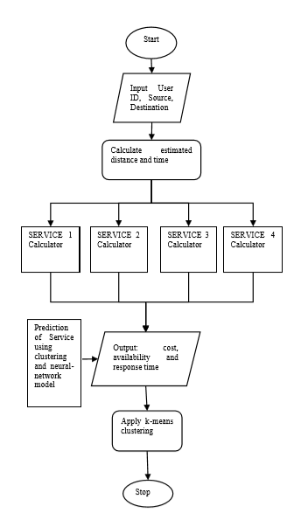
Proposed Model

Slide 7
Architecture of the Model
Java GUI Framework
Google Distance, Google Time
AWS Web Services
User
Online Database

Slide 8
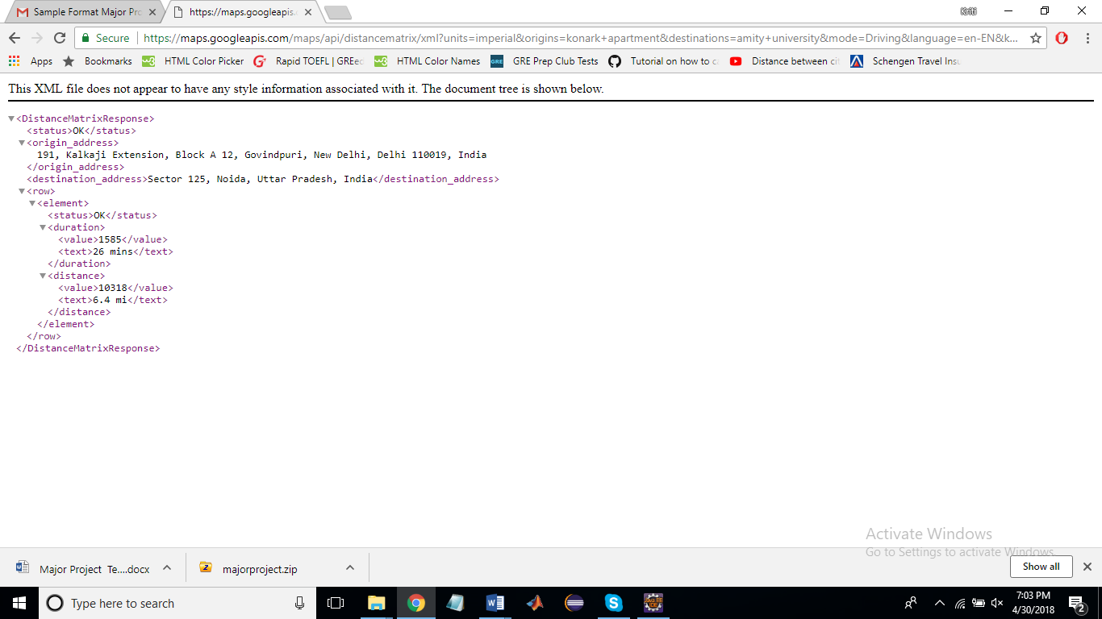
Google API output:

Slide 9
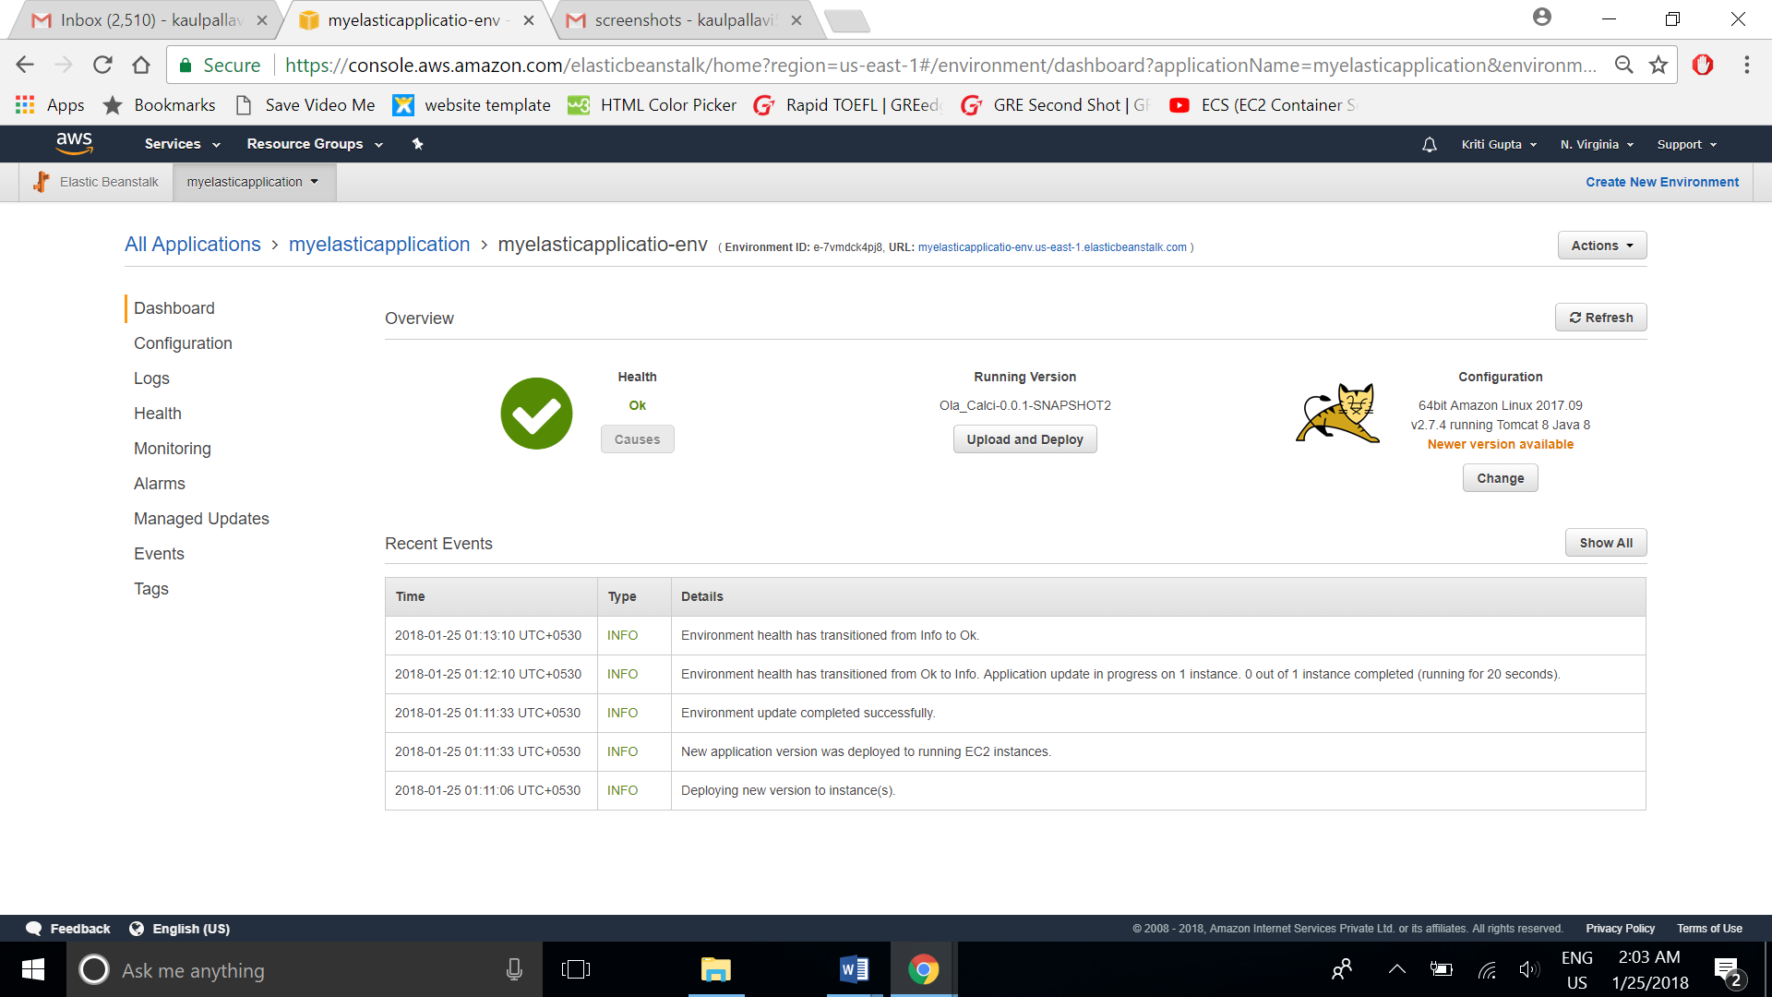
Deployed on AWS elastic bean stalk

Slide 10
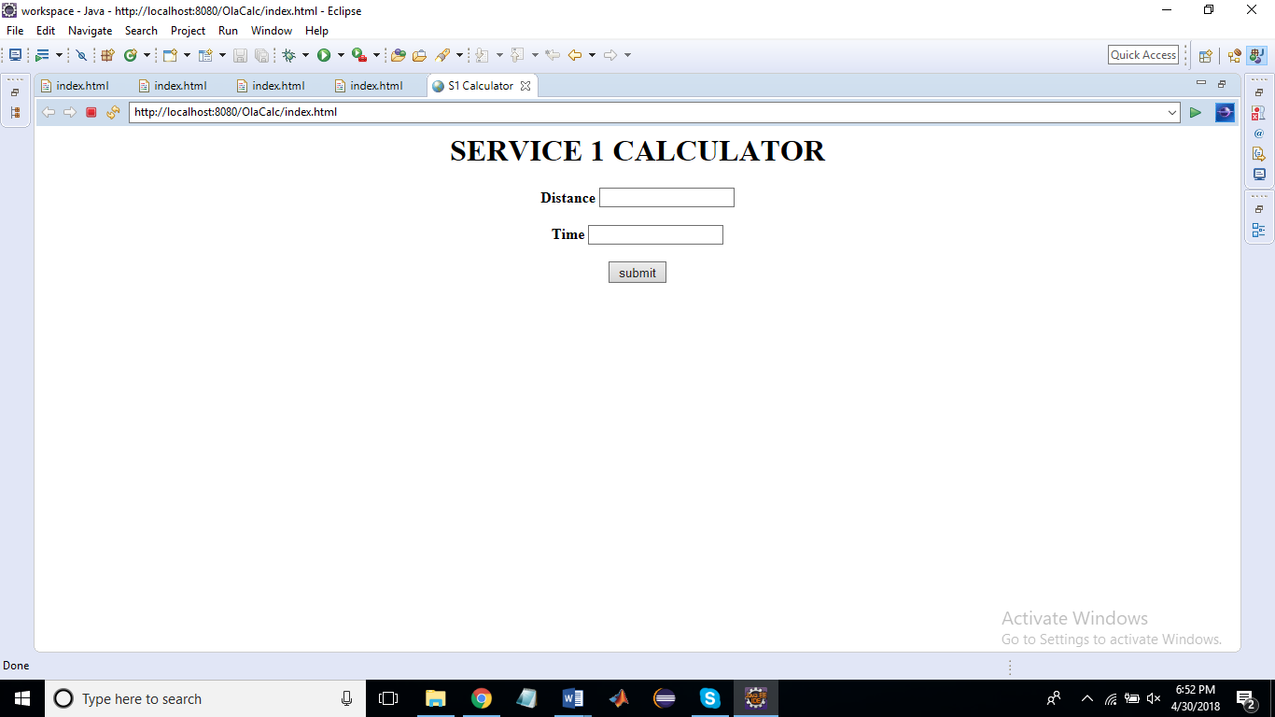
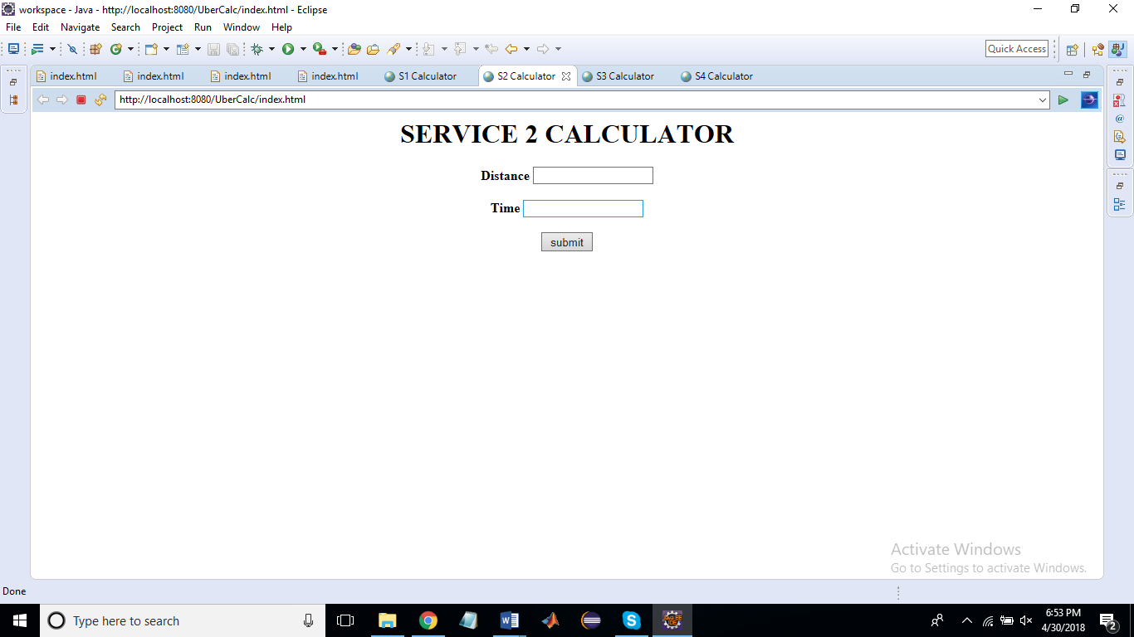
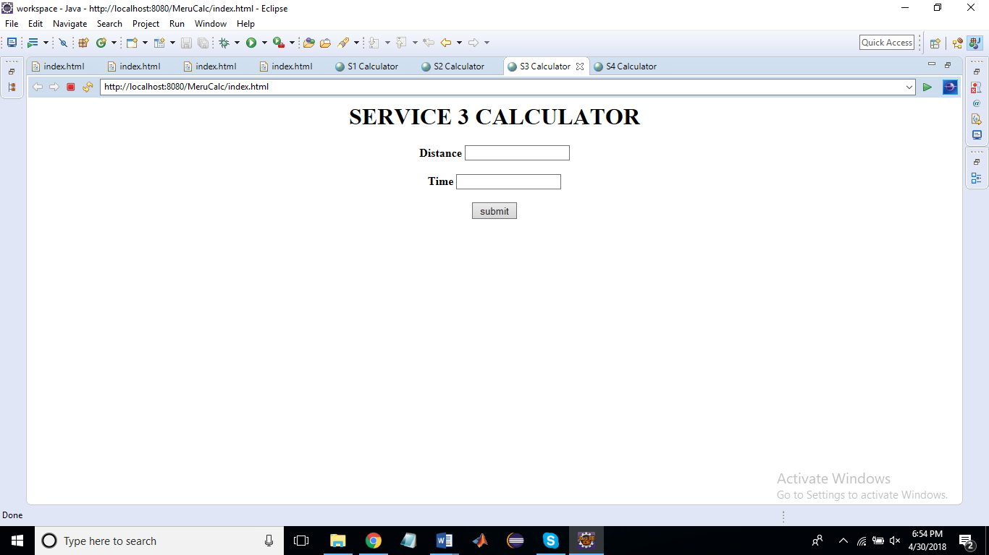
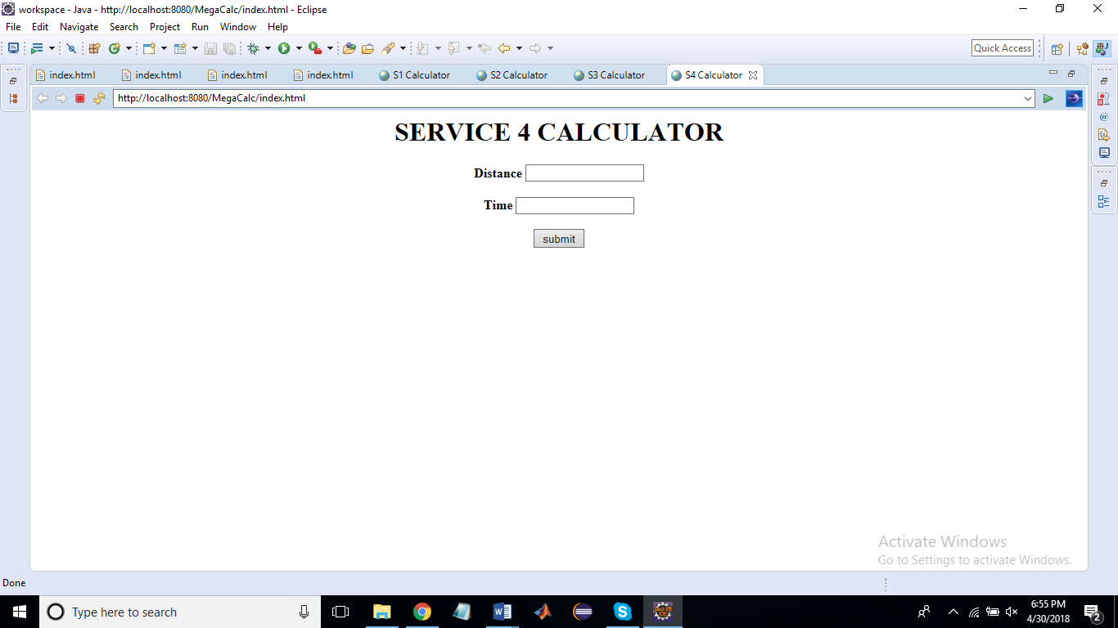
Web services to calculate time and distance
Importing data from data generation model:

Slide 11
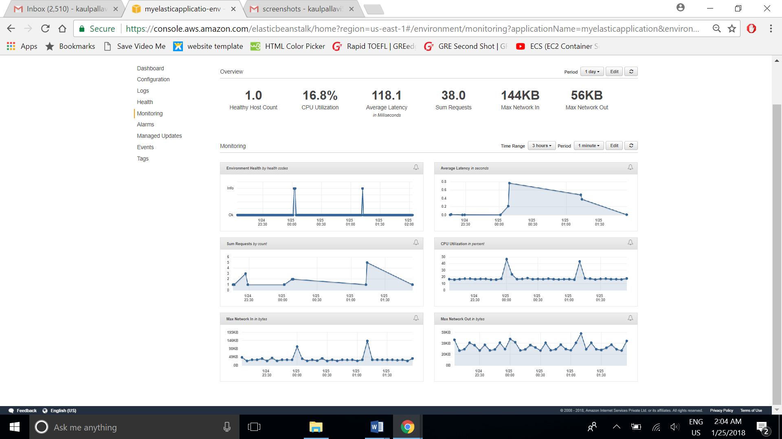
Analysis on AWS

Slide 12
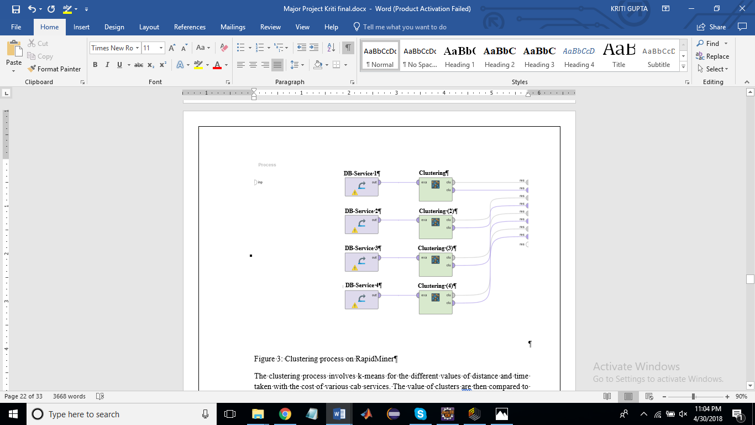
K-means design

Slide 13
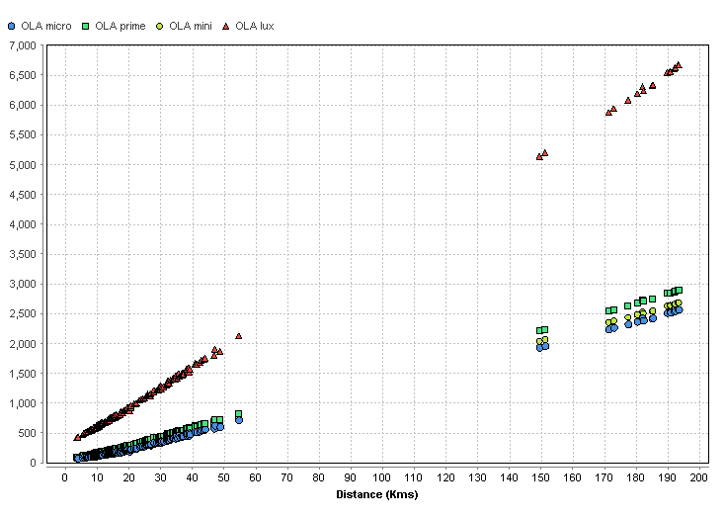
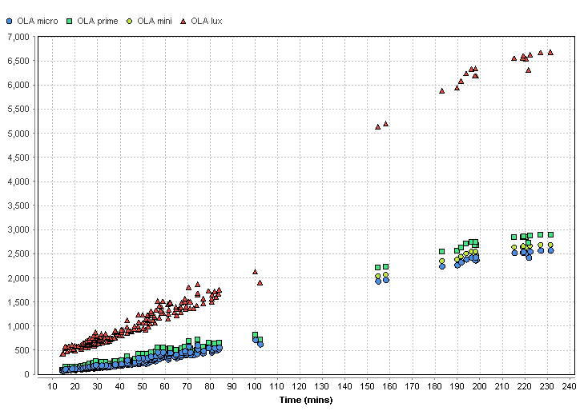
RESULTS
SERVICE 1
Nominal_value | Absolute Count | Fraction
cluster_0 | 114 | 0.5643564356435643
cluster_1 | 20 | 0.09900990099009901
cluster_2 | 68 | 0.33663366336633666

Slide 14
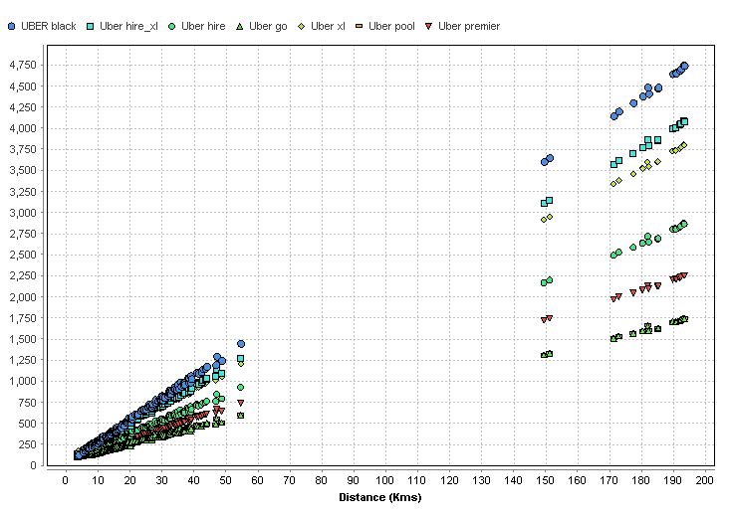
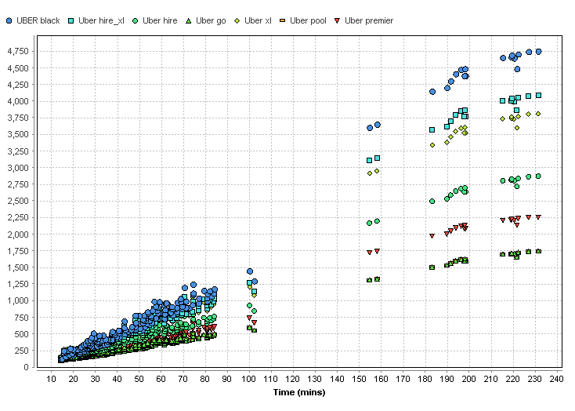
RESULTS
SERVICE 2
Nominal_value | Absolute Count | Fraction
cluster_0 | 20 | 0.09900990099009901
cluster_1 | 110 | 0.5445544554455446
cluster_2 | 72 | 0.3564356435643564

Slide 15
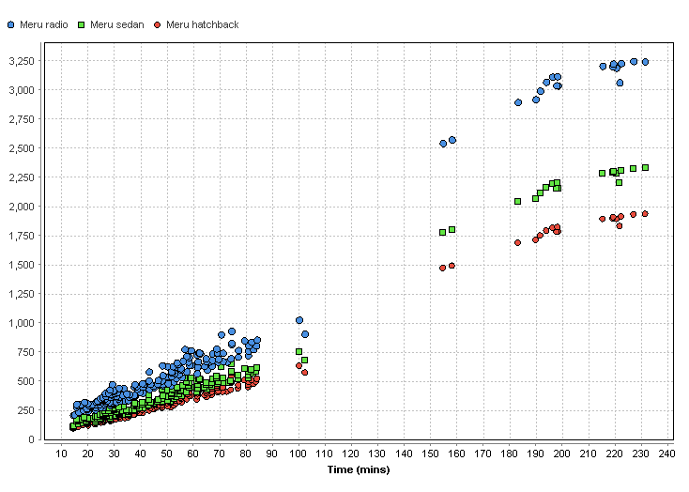
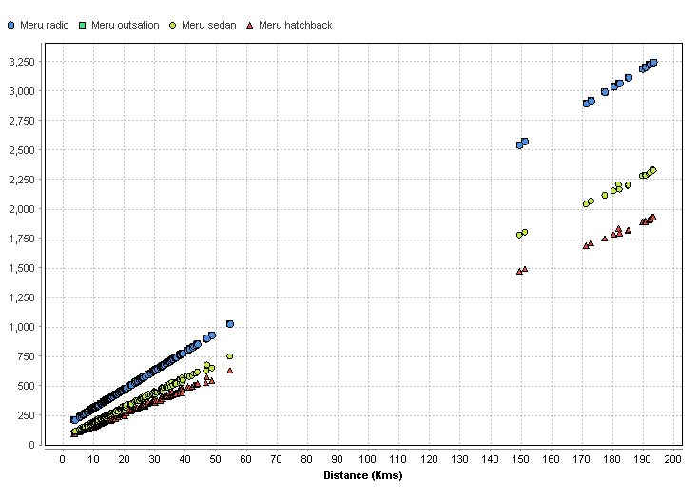
RESULTS
SERVICE 3
Nominal_value | Absolute Count | Fraction
cluster_0 | 110 | 0.5445544554455446
cluster_1 | 20 | 0.09900990099009901
cluster_2 | 72 | 0.3564356435643564

Slide 16
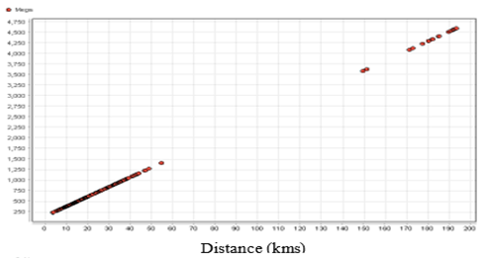
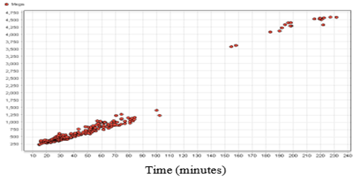
RESULTS
SERVICE 4
Nominal_value | Absolute Count | Fraction
cluster_0 | 20 | 0.09900990099009901
cluster_1 | 71 | 0.35148514851485146
cluster_2 | 111 | 0.5495049504950495

Slide 17
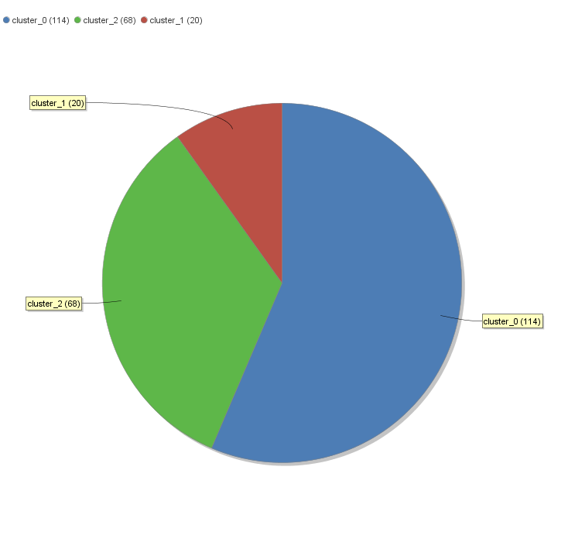
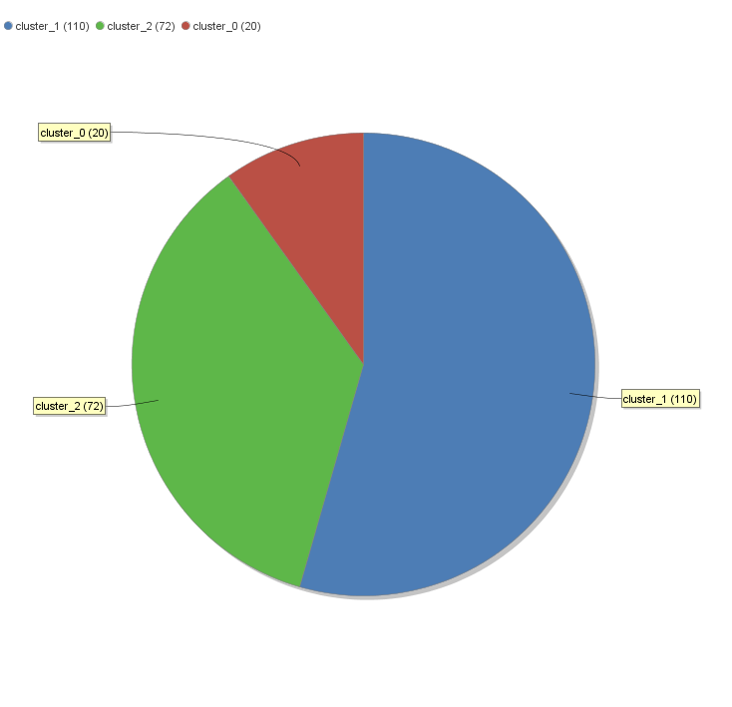


RESULTS
SERVICE 1
SERVICE 2
SERVICE 3
SERVICE 4

Slide 18
CONCLUSION AND FUTURE WORK
The proposed mathematical model aims at developing 4 web services named as SERVICE 1, SERVICE 2, SERVICE 3 and SERVICE 4 in AWS using Amazon EC2 service and Elastic Beanstalk. Calculators are designed in order to calculate the approximate cost using distance and time as input using Google API. The clusters are formed using k-means clustering in RapidMiner.
The methodology in the project is highly competent and precise. It provides faster and better results as compared to existing methodologies. It can provide best service with inputs from any predictive model.
In future, work can be done to improve the model with the help of increase in the number of policies and the load applied on the system.

Slide 19
THANK YOU

